Slide 1
Module 3 Informed Search AO*
Nirmala Shinde Baloorkar
Assistant Professor
Department of Computer Engineering

Slide 2
AO* Introduction
Its an informed search and works as best first search.
AO* algorithm is based on problem decomposition (breakdown problem into small pieces)
It represents an AND-OR graph algorithm that is used to find more than one solution.
Its an efficient method to explore a solution path

Slide 3
Problem Reduction
Problem Reduction
Divide and conquer strategy, a solution to a problem can be obtained by decomposing it into smaller sub-problems.
Each of this sub-problem can then be solved to get its sub solution.
These sub solutions can then recombined to get a solution as a whole. That is called is problem reduction.
AND-OR graphs/trees are used for representing the solution.
which are used in decision-making problems where some subproblems must be solved together (AND nodes)
and others can be solved independently (OR nodes)
It is particularly useful in game trees, planning, and AI applications

Slide 4
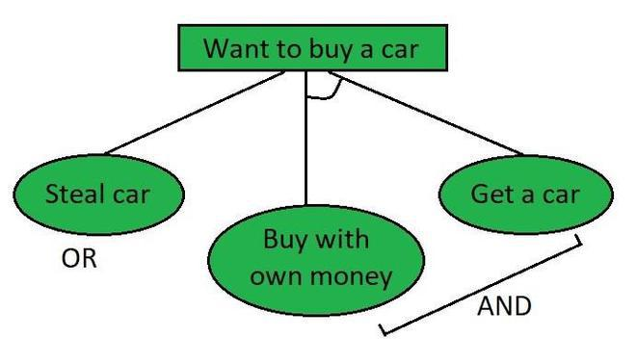
Example
Consider the process of buying a car
Notes:
The AND section might include securing funds or applying for a loan,
while the OR section could present different options for acquiring the car, such as purchasing with cash or financing.
Each subproblem in the AND-OR graph must be solved before the main issue is resolved.

Slide 5
AO* Algorithm
The AO* algorithm works by utilizing a tree structure where each node represents a state in the problem space.
The key components of the algorithm are:
Node Types
Heuristic Function
Search Process
Total Estimated Cost
Notes:
AO* Algorithm

Slide 6
AO* Algorithm – Node Types
AND Nodes:
Represent states where all child nodes must be satisfied to achieve a goal.
If a task requires multiple conditions to be met, it would be represented as an AND node.
OR Nodes:
Represent states where at least one child node must be satisfied to achieve a goal.
This type is useful in scenarios where multiple paths can lead to a solution.

Slide 7
AO* Algorithm – Heuristic Function
Node in the graph will point both down to its successors and up to its parent nodes.
Each node in the graph will also have a heuristic value associated with it.
f(n) = g(n) + h(n)
where,
g(n): actual cost / edge value.
h(n): heuristic / estimated value of the nodes
f(n): cost function

Slide 8
AO* Algorithm – Heuristic Function
Similar to A*, to estimate the cost to reach the goal from any given node.
This function helps in determining the most promising paths to explore.
The heuristic function h(n) estimates the cost to reach the goal from node n:
h(n)=estimated cost to reach the goal from node

Slide 9
AO* Algorithm – Search Process
The search begins at the initial node and explores its child nodes based on the type (AND or OR).
For OR Nodes: The algorithm considers the lowest cost among the child nodes. The cost for an OR node can be expressed as:
C(n)=min{C(c1​),C(c2​),…,C(ck​)}
where C(n) is the cost of node n and c1,c2,…,ckc1​,c2​,…,ck​​ are the child nodes of n.
For AND Nodes: The algorithm computes the cost of all child nodes and selects the maximum cost, as all conditions must be met. The cost for an AND node can be expressed as:
C(n)=max{C(c1​),C(c2​),…,C(ck​)}
where C(n) is the cost of node n, and c1,c2,…,ckc1​,c2​,…,ck​​ are the child nodes of n.

Slide 10
AO* Algorithm – Total Estimated Cost
The total estimated cost f(n)f(n) at any node nn is given by:
f(n)=C(n)+h(n)
where:
C(n) is the actual cost to reach node n from the start node.
h(n) is the estimated cost from node n to the goal.
Stepwise Algorithm

Slide 11
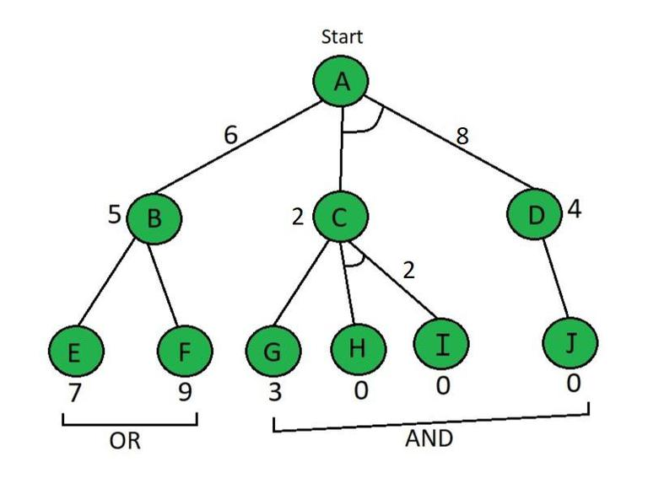
Example
Each node in the graph is assigned a heuristic value, denoted as h(n), and the edge length is considered as 1.
Notes:
https://www.geeksforgeeks.org/ao-algorithm-artificial-intelligence/

Slide 12
Step 1
Starting from node A, we use the evaluation function
For the path involving OR nodes (B)
f(A -> B) = g(B) + h(B)
= 1 + 5 (g(n) = 1 is the default path cost)
= 6
For the path involving AND nodes (C and D):
f(A -> C + D) = g(C) + h(C) + g(D) + h(D)
= 1 + 2 + 1 + 4 (C & D are AND nodes)
= 8
Since f(A -> B) = 6 is smaller than f(A -> C + D) = 8,
we select the path A -> B.

Slide 13
Step 2
Explore Node B
Calculate the values for nodes E
f(B -> E) = g(E) + h(E)
= 1 + 7
= 8
Calculate the values for nodes F
f(B -> F) = g(F) + h(F)
= 1 + 9
= 10
Since f(B-> E) = 8 is smaller than f(B -> E) = 10,
we select the path B -> E.

Slide 14
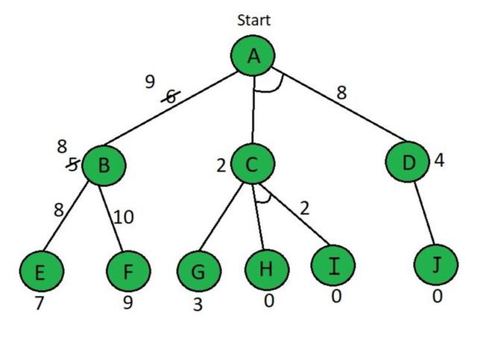
Step 2
Thus, f(B -> E) = 8 is chosen as the optimal path. Since B’s heuristic value differs from its actual cost, we update the heuristic for A.
f(A -> B) = g(B) + updated h(B)
= 1 + 8
= 9
Notes:
So, by above calculation B⇢E path is chosen which is minimum path, i.e f(B⇢E) because B’s heuristic value is different from its actual value The heuristic is updated and the minimum cost path is selected. The minimum value in our situation is 8. Therefore, the heuristic for A must be updated due to the change in B’s heuristic.

Slide 15
Step 3
Now, we compare f(A -> B) = 9 with f(A -> C + D) = 8. Since f(A -> C + D) is smaller, we explore this path and move to node C.
f(C -> G) = g(G) + h(G) = 1 + 3 = 4
f(C -> H + I) = g(H) + h(H) + g(I) + h(I) = 1 + 0 + 1 + 0 (H & I are AND nodes) = 2
Since f(C -> G) = 4 is greater than f(C⇢H+I) = 2,
we select the path f(C⇢H+I)

Slide 16
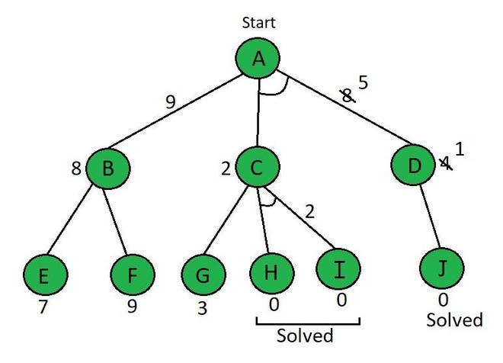
Step 3
Calculate for node D.
f(D -> J) = g(J) + h(J) = 1 + 0 = 1
After updating the heuristic for D, we recalculate
f(A -> C + D) = g(C) + h(C) + g(D) + h(D) = 1 + 2 + 1 + 1 = 5
Notes:
https://www.slideshare.net/slideshow/ao-star-algorithm-in-artificial-intellligence/276016571

Slide 17
AO* Algorithm
Advantages
It is complete
Will not go in infinite loop
Less memory required
Disadvantages
It is not optimal as it does not explore all the path once it find a solution.

Slide 18
Comparison
Feature | A* Algorithm | AO* Algorithm
Graph Type | OR-Graph (finds a single solution) | AND-OR Graph (finds multiple solutions)
Purpose | Used for pathfinding and graph traversal to find the most efficient path to the goal. | Used for problem-solving where multiple paths must be considered simultaneously.
Solution Approach | Finds one optimal path from the start node to the goal node. | Finds multiple solutions by considering both AND and OR branches.
Traversal Strategy | Uses a best-first search with heuristic cost estimation. | Expands the most promising paths while ensuring all conditions of AND nodes are met.

Slide 19
Comparison
Feature | A* Algorithm | AO* Algorithm
Cost Calculation | Total cost = Cost from the start node to the current node + Estimated cost from the current node to the goal. | Cost is accumulated for all possible paths originating from a node, considering whether they lead to the goal state or not.
Handling of Nodes | Expands one node at a time based on the least cost. | Expands multiple nodes if they are part of an AND condition.
Usage | Used in navigation, AI, robotics, and games. | Used in AI planning, expert systems, and decision-making.

Slide 20
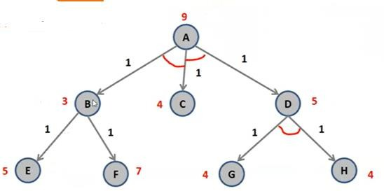
Example 2

Slide 21
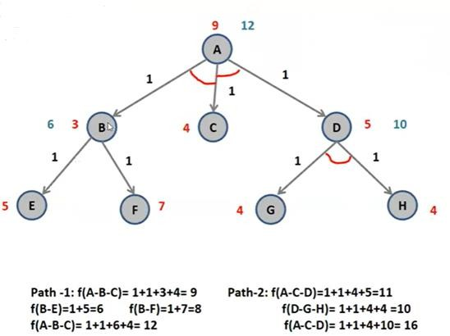
Example 2 Solution

Slide 22
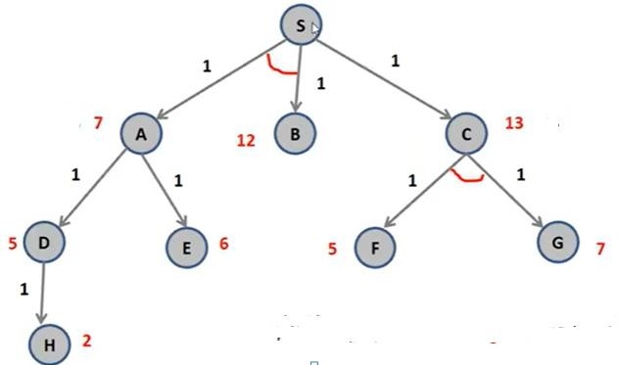
Example 3

Slide 23
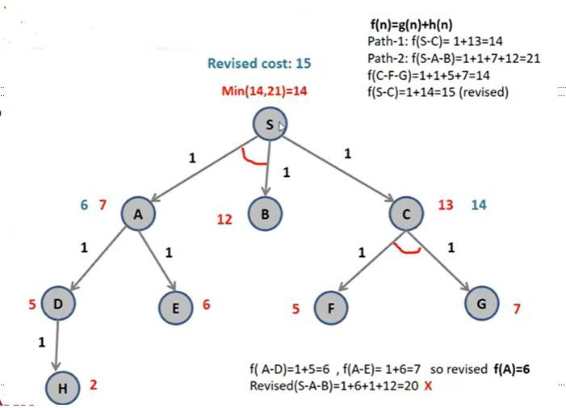
Example 3 Solution

Slide 24
References
Stuart Russell,Peter Norvig, “Artificial Intelligence-A Modern Approach”, Pearson.
Elaine Rich and Kevin Knight, “Artificial Intelligence”, McGraw-Hill.
E Charniak and D McDermott, “Introduction to Artificial Intelligence”, Pearson.
https://www.javatpoint.com/ai-informed-search-algorithms
https://www.geeksforgeeks.org/best-first-search-informed-search/
Disclaimer: The e-content is exclusively meant for academic purposes and for enhancing teaching and learning. Any other use for economic/commercial purpose is strictly prohibited. The users of the content shall not distribute, disseminate or share it with anyone else and its use is restricted to advancement of individual knowledge. The information provided in this e-content is developed from authentic references, to the best of my knowledge.

